Slide 1


IMADUDDIN
12 January 2023

Slide 2


Outline
Executive Summary
Introduction
Methodology
Results
Conclusion
Appendix

Slide 3
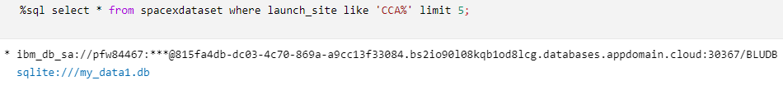
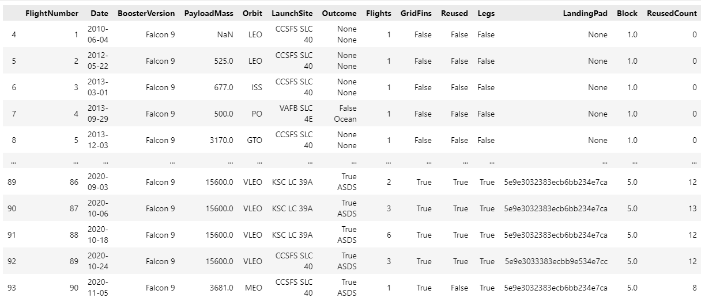
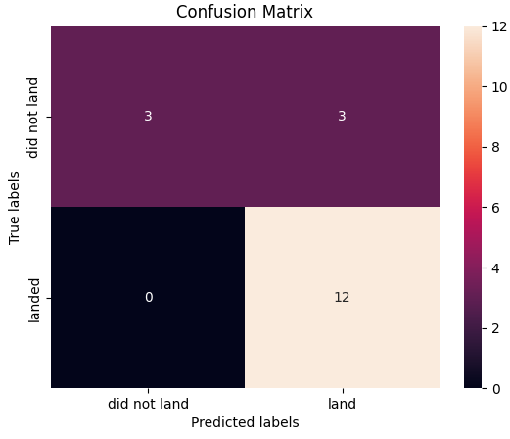
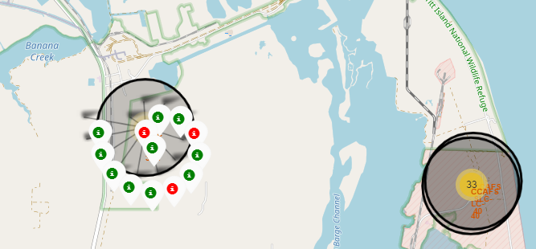
Executive Summary
Methods :
Data Collection using SpaceX API, Web Scrapping & Wrangling
Exploratory Data Analysis (EDA) : SQL, Matplotlib, Pandas
Visual & Dashboard (Folium, Analytics, Plotly Dash)
Machine Learning Prediction (Logistic, SVM, KNN, Tree)
Results :
Data Extract & Analysis with Interactive Visualization
Best Model for Predictive Analysis

Slide 4
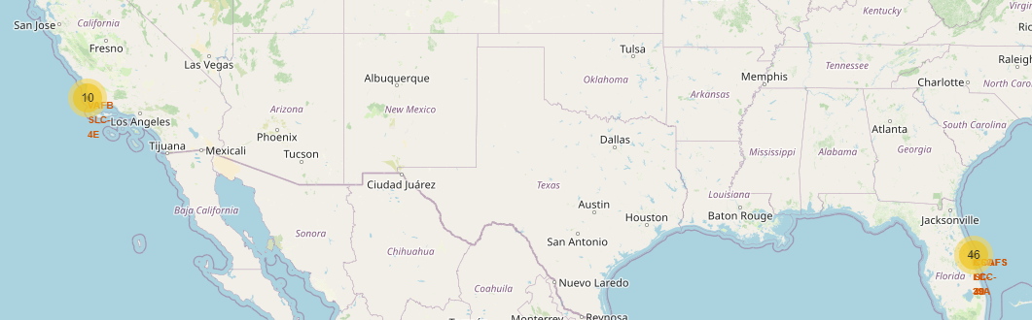
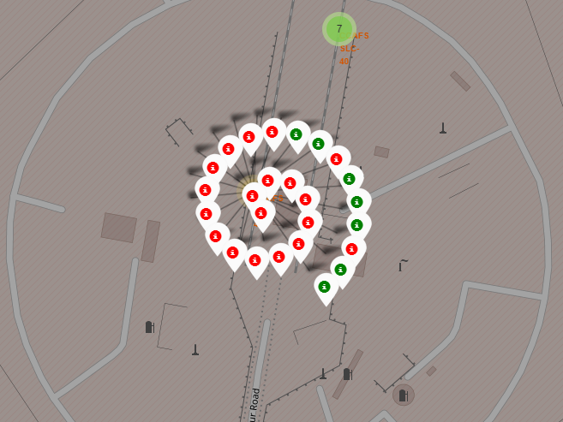
Introduction
Project background and context :
Objective : “evaluate the eligibility & viability of the new company ‘Space Y’ to compete ‘Space X’ by optimizing total cost for launches”
Problems you want to find answers :
Best model to predict successful landing of 1st stage rocket with all determining factors (Launch Site, Orbit, etc..)

Slide 5

Section 1

Slide 6
Methodology
Executive Summary
Data collection methodology:
Source : Space X Rest API (https://api.spacexdata.com/v4/rockets/)
Web Scraping : https://en.wikipedia.org/wiki/List_of_Falcon/_9/_and_Falcon_Heavy_launches
Perform data wrangling
Dropping irrelevant data
By evaluating feature data, create a landing outcome label based on the outcome data
Perform exploratory data analysis (EDA) using visualization and SQL
Perform interactive visual analytics using Folium and Plotly Dash
Perform predictive analysis using classification models
Normalize data, divide train-test data set, evaluated by 4 models and judge by its best accuracy score

Slide 7
Data Collection
Gather data from established system (API or Web), to extract relevant data to be processed further
Extract Data from Space X API / Web
Build Data Frame
Filter, Drop Irrelevant Data
Export to raw file (i.e. : CSV)

Slide 8
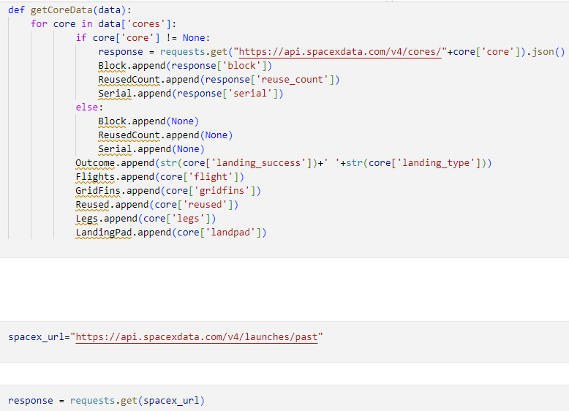
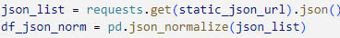
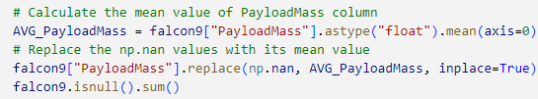
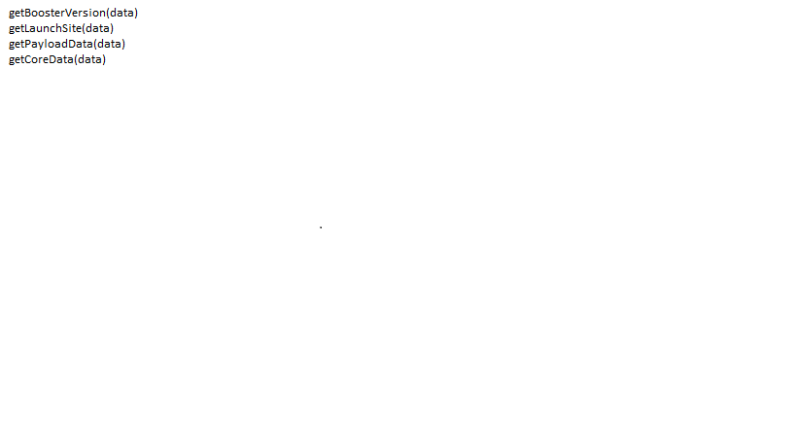
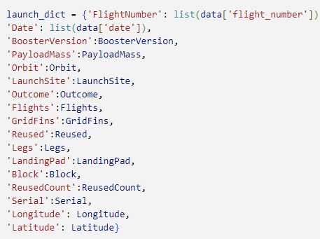
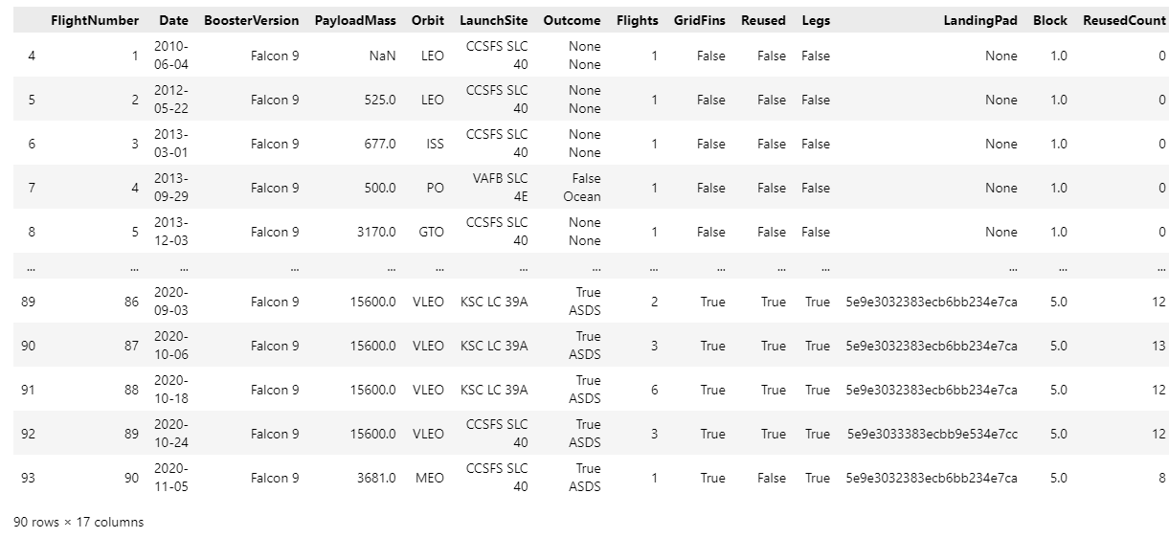
Data Collection – SpaceX API
SpaceX provide public API, data can be extracted and processed further
1.a
3.a
1.b
3.b
2.a
2.c
3.c
2.b
1. Request API & parse “SpaceX Launch” Data
Deal Missing Value
3. Deal With Dataframe :
Filter only Falcon 9
Request, Get Response
Convert Response to .json
2. Apply function
Get core data
Create Dataframe
Export to File (ex: CSV)
Assign List to Dictionary
Source : https://github.com/iim05te/SpaceX_Imaduddin/blob/main/IM_W1_01_Collect_Data.ipynb

Slide 9
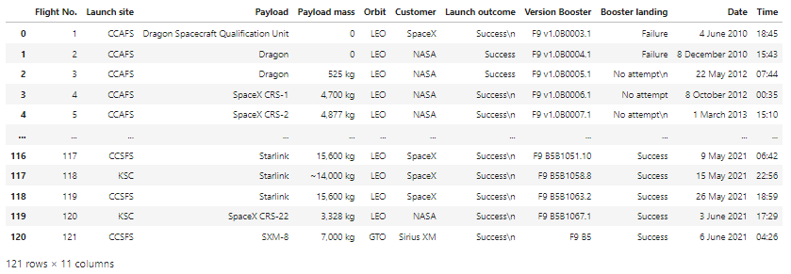
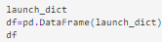
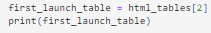
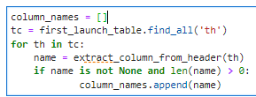
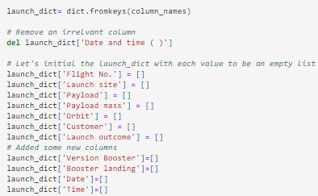
Data Collection - Scraping
Data obtained by scraping from Wikipedia
1.a
1.b
2.a
3.a
2.b
3.b
1. Request Wiki & parse “SpaceX Launch” Data
3. Deal Dataframe :
Convert dictionary to data frame
Request, Get Response HTML
Create BeautifulSoup Object
2. Extract column/variable from HTML Table Header
Find table
Get Column name
Create Dictionary, append data to keys
Convert to CSV
2.c
9
Source : https://github.com/iim05te/SpaceX_Imaduddin/blob/main/IM_W1_01_Collect_WebScrap.ipynb

Slide 10
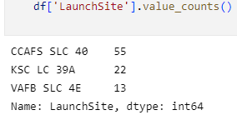
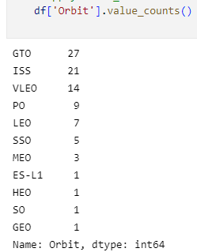
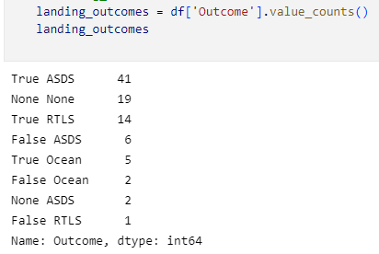
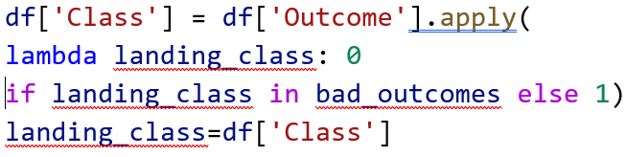
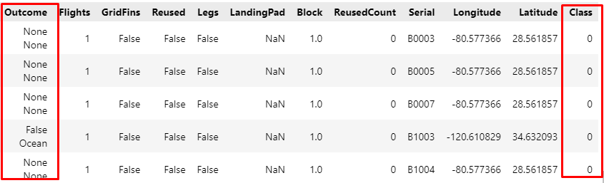
Data Wrangling
Data cleaned, unify messy and complex data set to ease access and analyze. Convert “Outcome column” into Training Labels for booster landing (1 : success, 0 : fail)
A. Calculate Number of Launces each Site
B. Calculate number and occurrence on each orbit
C. Calculate number and occurrence of mission outcome per orbit
D. Create Landing Outcome Label & Export to raw file (i.e. : CSV)
Source : https://github.com/iim05te/SpaceX_Imaduddin/blob/main/IM_W1_02_Wrangling.ipynb

Slide 11
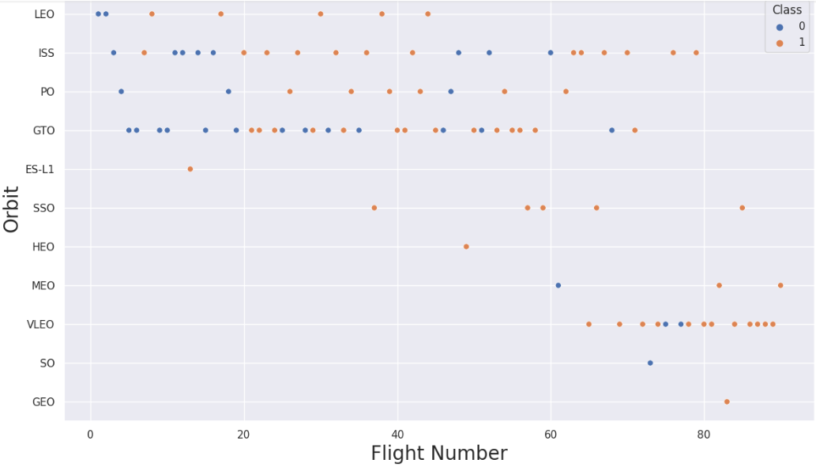
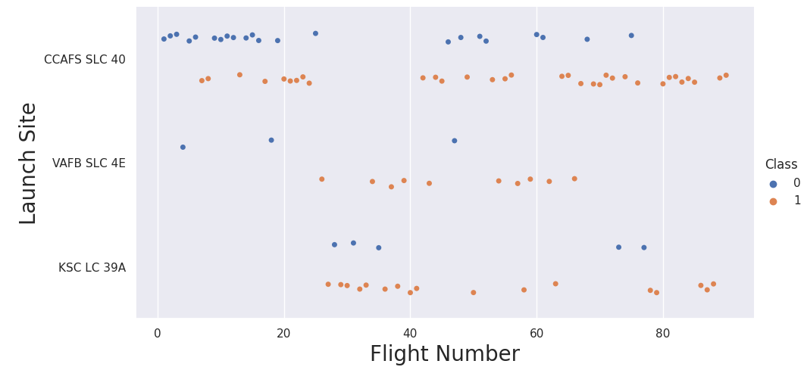
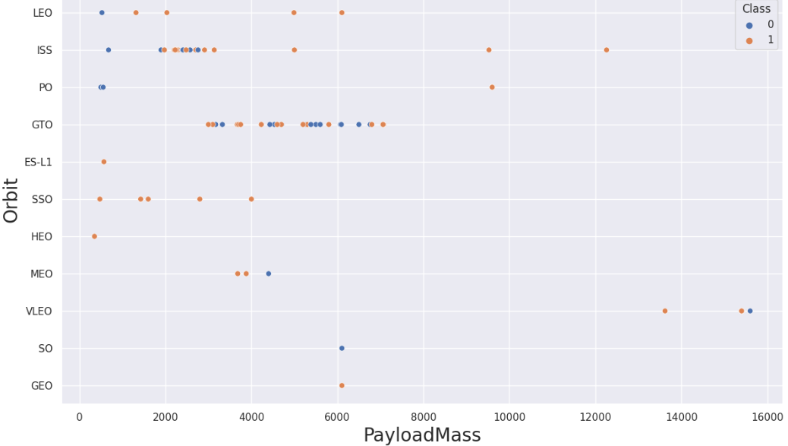
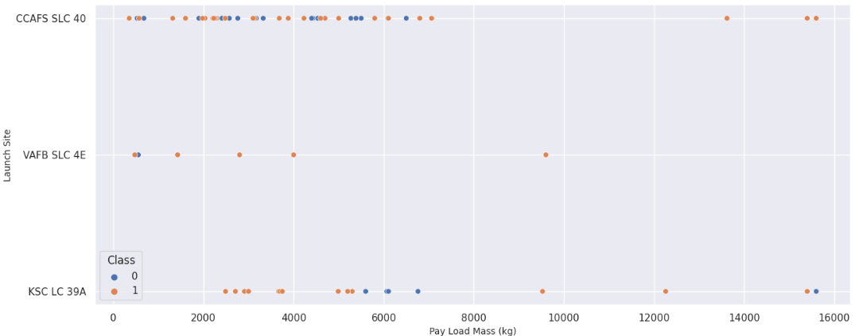
EDA with Data Visualization (1/2)
Source : https://github.com/iim05te/SpaceX_Imaduddin/blob/main/IM_W2_01_Visual.ipynb
Using Scatter, Bar Chart, Line Chart for EDA
I. Scatter (to show dependency of each attribute)
Launch Site vs Flight Number Correlation :
no certain correlation decision to be made if the Flight Number is dependent / relevance on Launch Site for a success launch
Orbit vs Flight Number Correlation :
LEO orbit : the Success related to number of flights
GTO orbit : no relationship between flight number
Launch Site vs Payload mass (kg) Correlation :
On VAFB-SLC : no rockets launched for payload mass > 10 tons
Orbit vs Payload mass (kg) Correlation :
Polar, LEO and ISS : More heavy payloads, more success landing / positive landing rate
GTO : cannot be distinguished

Slide 12
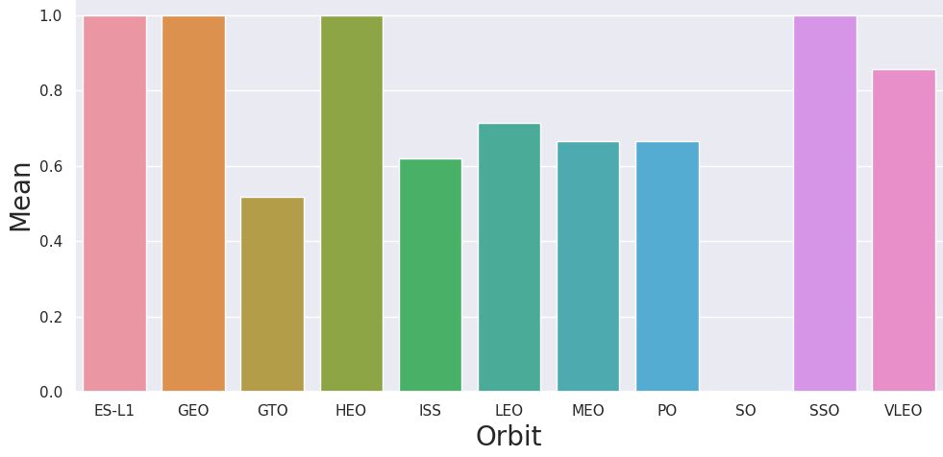
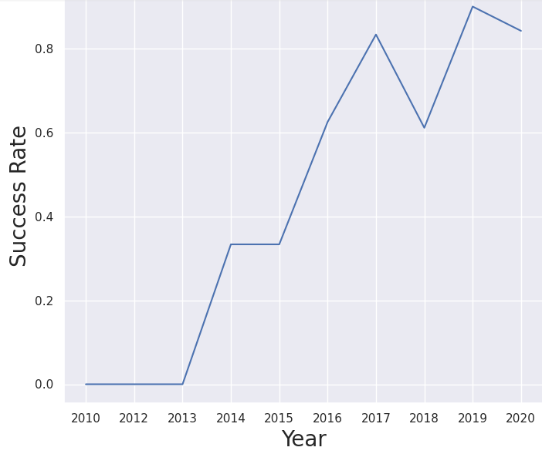
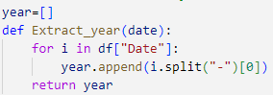
EDA with Data Visualization (2/2)
Source : https://github.com/iim05te/SpaceX_Imaduddin/blob/main/IM_W2_01_Visual.ipynb
II. Bar Chart (to show which Orbit with most successful landing)
Orbit with Mean of Success Rate :
ES-L1,GE,HEO, SSO have highest mean success rate
III. Line Chart (to show the trend)
Launch Success Yearly Trend :
Success rate keep increasing from 2013 to 2020 (generally)

Slide 13
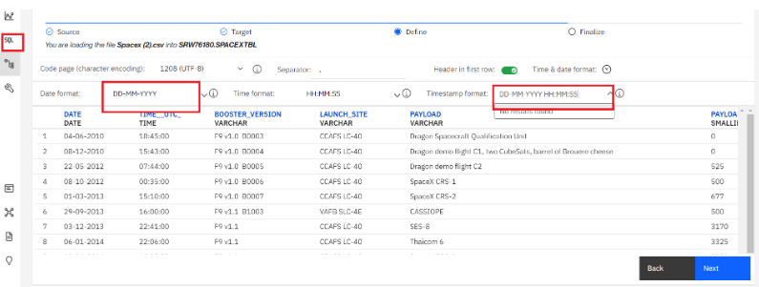
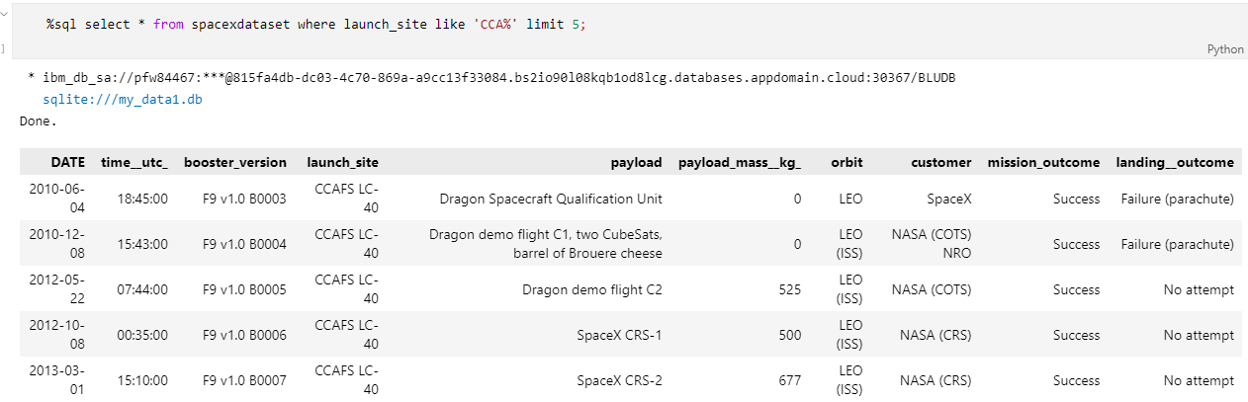
EDA with SQL
Source : https://github.com/iim05te/SpaceX_Imaduddin/blob/main/IM_W2_01_SQL.ipynb
SQL queries using Db2 Cloud
IBM Db2 Cloud
Names of launch sites;
Top 5 launch sites whose name begin with the string 'CCA’;
Total payload mass carried by boosters launched by NASA (CRS);
Average payload mass carried by booster version F9 v1.1;
Date when the first successful landing outcome in ground pad was achieved;
Names of the boosters which have success in drone ship and have payload mass between 4000 and 6000 kg;
Total number of successful and failure mission outcomes;
Names of the booster versions which have carried the maximum payload mass;
Failed landing outcomes in drone ship, their booster versions, and launch site names for in year 2015;
Rank of the count of landing outcomes (such as Failure (drone ship) or Success (ground pad)) between the date 2010-06-04 and 2017-03-20

Slide 14
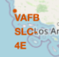
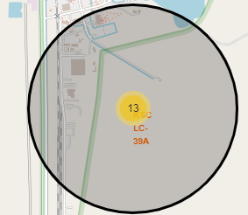
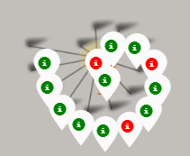
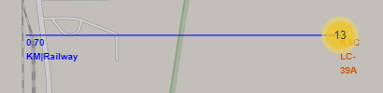
Build an Interactive Map with Folium
1
Markers indicate points like launch sites;
Circles indicate highlighted areas around specific coordinates, (i.e. : NASA)
Marker clusters object to simplify a map containing multiple markers in the same coordinates; indicates groups of events in each coordinate (i.e. : success / failure launches in a launch site)
Lines are used to indicate distances between two coordinates (to anticipate railway, highway, city and coastline risk mitigation impact on failure landing)
2
3
4
Source : https://github.com/iim05te/SpaceX_Imaduddin/blob/main/IM_W3_01_Folium.ipynb

Slide 15
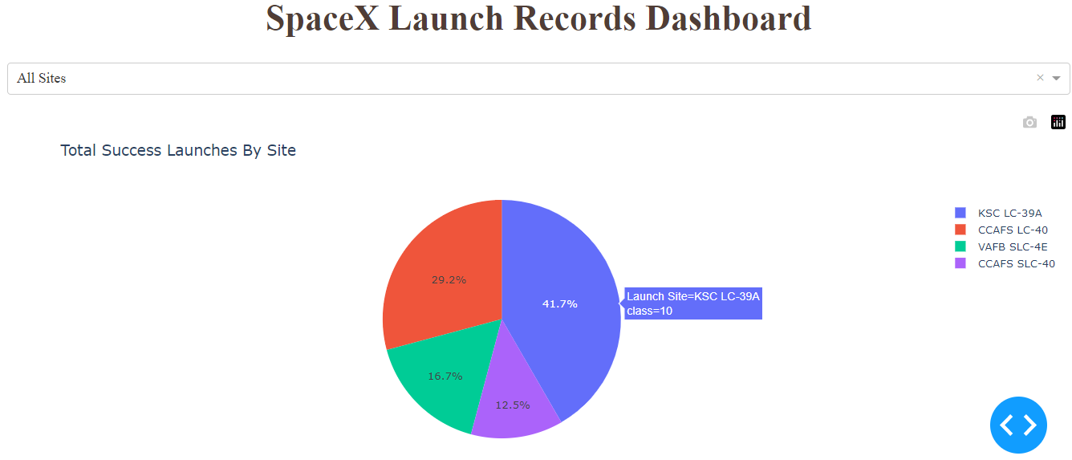
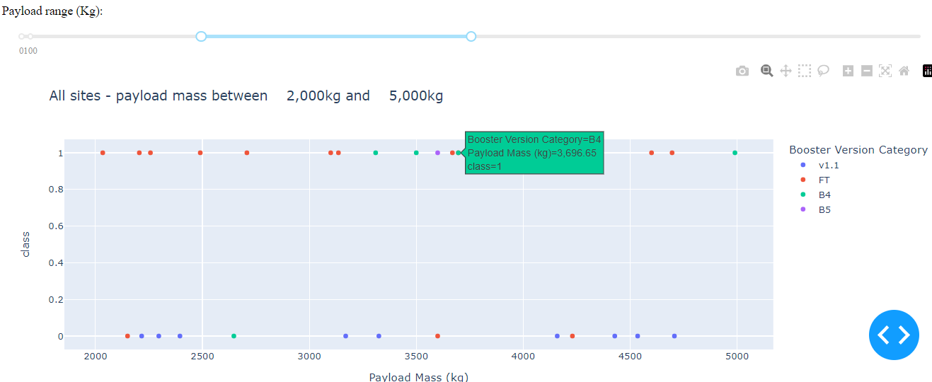
Build a Dashboard with Plotly Dash
Pie Chart to summarize total success launch for all launch site & dropdown on certain site in percentage
Scatter Plot to show correlation between success rate vs booster version category on sites by sliding Payload mass (kg) on all launch sites to help decide best launch site according to payload mass
Source : https://github.com/iim05te/SpaceX_Imaduddin/blob/main/IM_W3_plotly/IM_W3_plotly.py

Slide 16
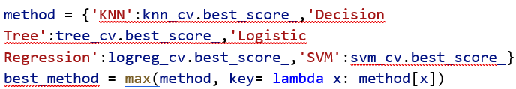
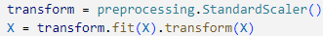
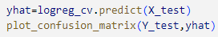
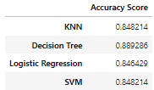
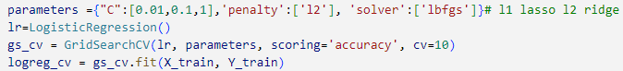
Predictive Analysis (Classification)
1. Modelling
Load to Dataframe
Transform into NumPy Array
2. Evaluate on each Model
Check accuracy Score
Get best hyperparameter
3. Choose Best Score
Compare each Accuracy Score
Choose the best Accuracy Score
Standardize & Transform
Split (Train-Test)
Pick a Method (1 by 1)
Set Parameter & Algorithm on GridSearchCV
Fit data into GridSearchCV object & train model
Plot Confusion Matrix
4 Method used (LR / Logistic Regression, SVM / Support Vector Machine, KNN / K - Nearest Neighbors, DT / Decision Tree), compare its Accuracy Score, then choose the best score.
1
2
3
Source : https://github.com/iim05te/SpaceX_Imaduddin/blob/main/IM_W4_01_ML.ipynb

Slide 17
Results (Recap)
Exploratory data analysis results
Interactive analytics demo in screenshots
Predictive analysis results

Slide 18
Results (1/3 : EDA)
Visualization :
Scatter Plot Dependency Attribute :
Payload vs Launch Site : no rockets launched from VAFB-SLC for payload mass > 10 tons
Orbit vs Number of Flight : the Success on LEO orbit related to number of flights
Orbit vs Payload : in PO, LEO and ISS : more heavy payloads, more success landing / positive landing rate
Bar Chart Categorical Orbit : ES-L1,GE,HEO, SSO have highest mean success rate
Plot Line Trend : The number of landing outcomes became as better as years passed since 2013
SQL :
Space X uses 4 different launch sites
The first launches were done to Space X itself and NASA
Average payload mass of F9 v1.1 booster is 2,928 kg
1st success landing in 2015 five year after the first launch
Many Falcon 9 booster versions were successful at landing in drone ships having payload above the average
Almost 100% of mission outcomes were successful
Two booster versions failed at landing in drone ships in 2015: F9 v1.1 B1012 and F9 v1.1 B1015

Slide 19
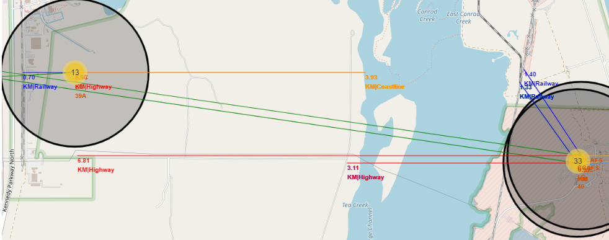
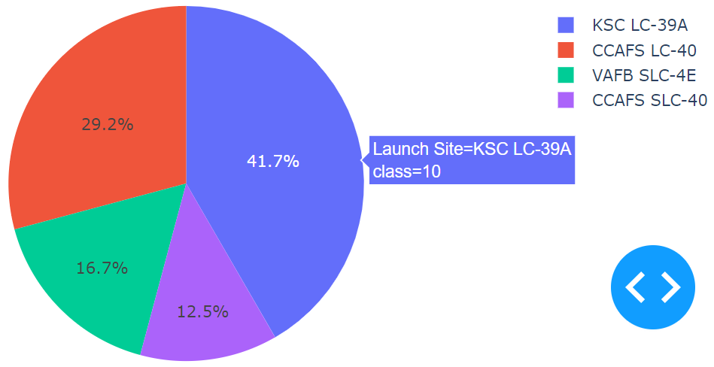
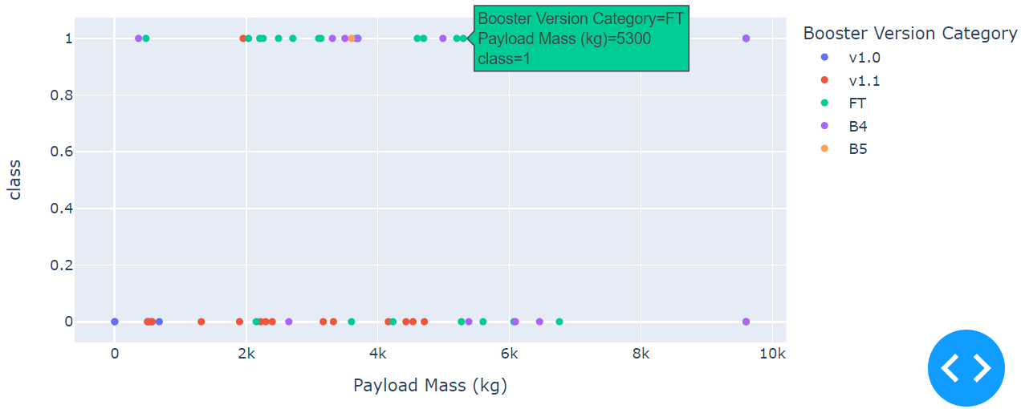
Results (2/3 : Interactive Analytic Demo)
1. Folium : showing Best & Safety Place to launch (in distance)
near coastline and far from city to minimize the risk
near logistic infrastructure around
2. Dash :
10 success launch in KSC LC-39A (41.7 %)
Booster Version Category FT have more success launch
1
2
2

Slide 20
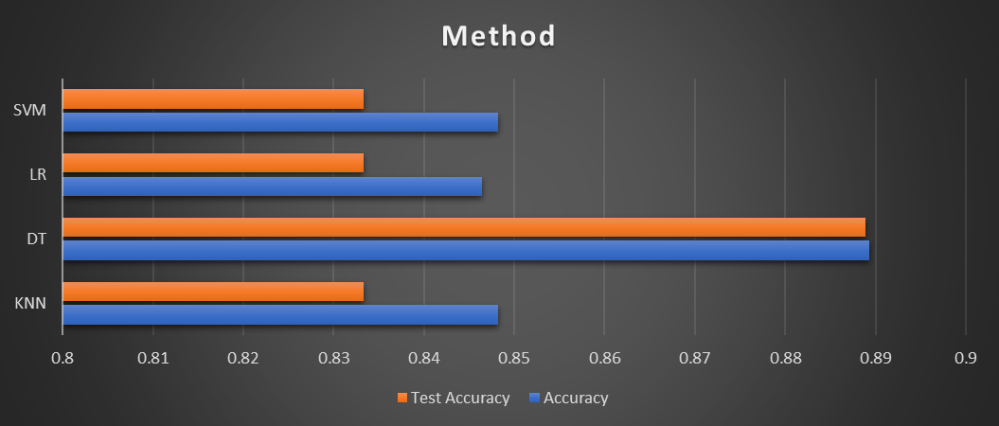
Results (3/3 : Predictive analysis results)
Predictive analysis showed that Decision Tree has the best Accuracy Score for a model to predict successful landings, Accuracy Score 88.93 %

Slide 21

Section 2

Slide 22
Flight Number vs. Launch Site
+25
most of launch on CCAFS SLC-40, but only 60% successful, KSC LC 39A & VAFB SLC 4E has 77 % success rate, need to be verified further
After flight number +25, KSC LC 39A & VAFB SLC 4E have higher success rate
But no certain correlation decision to be made if the Flight Number is dependent / relevance on Launch Site for a success launch

Slide 23
Payload vs. Launch Site
+7k
no rockets launched from VAFB-SLC for payload mass > 10 tons
Payloads mass > + 7 tons have most success rate;
Payloads mass > + 10 tons seems only possible launched from CCAFS SLC 40 and KSC LC 39A
no certain pattern if the launch site dependent on Pay Load Mass for a success launch

Slide 24
Success Rate vs. Orbit Type
ES-L1,GE,HEO, SSO have highest mean success rate

Slide 25
Flight Number vs. Orbit Type
Success rate improved over time on all orbit (flight number increases on each orbit)
the Success on LEO orbit related to number of flights
VLEO could be opportunity, since recent frequent flight
no real pattern on GTO

Slide 26
Payload vs. Orbit Type
Polar, LEO and ISS : More heavy payloads, more success rate
ISS has widest range of payload and good success rate
GTO : cannot be distinguished

Slide 27
Launch Success Yearly Trend
Success rate keep increasing from 2013 to 2020 (generally)
Seems 2010-2013 were a period time for adjustment & improvement analysis (budget and technology

Slide 28
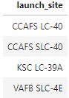
All Launch Site Names
%sql to use SQL extension on notebook
select distinct : to pull unique values of launch_site column from table spacexdataset

Slide 29
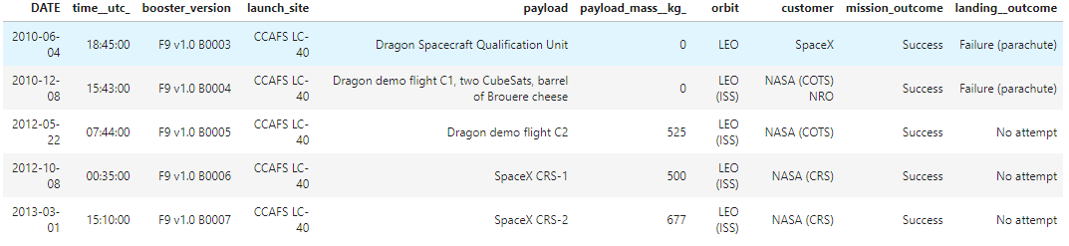
Launch Site Names Begin with 'CCA'
%sql to use SQL extension on notebook
select * : to pull all values of column from table spacexdataset
where launch_site like ‘CCA%’ : keyword wild card only launch_site begin with CCA, % in the end means can be any word after
limit 5 : only fetch 5 records

Slide 30
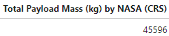
Total Payload Mass
sum : to pull sum in kg of payload mass column from table spacexdataset, summing all values
as “Total …” : alias to rename the new column as “Total …”
where customer= : keyword wild card customer exactly same as ‘NASA (CRS)’

Slide 31
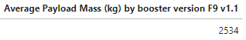
Average Payload Mass by F9 v1.1
avg : to pull averagein kg of payload mass column from table spacexdataset, calculating all values in col.
as “Average…” : alias to rename the new column as “Average …”
select * : to pull all values of column from table spacexdataset
where booster_version like ‘F9 v1.1%’ : keyword wild card only booster_version begin with F9 v1.1, % in the end means can be any word after

Slide 32

First Successful Ground Landing Date
min(DATE) : to pull minimum value on DATE column (MIN = the oldest date)
as “1st …” : alias to rename the new column as “1st …”
where landing_outcome= : keyword wild card customer exactly same as ‘Success (ground pad)’

Slide 33

Successful Drone Ship Landing with Payload between 4000 and 6000
select booster_version : to pull only booster version column from table spacexdataset
where landing_outcome= : keyword wild card landing_outcome exactly same as ‘Success (drone ship)’
and … between 4000 and 6000 : additional filter between 2 values

Slide 34

Total Number of Successful and Failure Mission Outcomes
select mission_outcome, count.. : to pull 1 column mission outcome and count all kind of it
as “Total …” : alias to rename the new column as “Total …”
group by ..= : to group by mission outcome and giving each counting records, summary

Slide 35

Boosters Carried Maximum Payload
select distinct : to pull unique values of booster_version column from table spacexdataset
as “Booster …” : alias to rename the new column as “Booster …”
where payload .. = : to filter with subquery regarding value of payload
..=(select max ..) : subquery pull maximum value of payload column, then being filter in main query

Slide 36


2015 Launch Records
monthname(date) : to pull month name value on DATE column
as “Month …” : alias to rename the new column as “Month …”
selected column : month name, landing outcome, booster version, launch site
where landing_outcome= : keyword wild card customer exactly same as ‘Failure (drone ship)’
and year(date)=2015 : additional filter by value of year on DATE column to be exactly 2015

Slide 37


Rank Landing Outcomes Between 2010-06-04 and 2017-03-20
select landing_outcome, count(landing_outcome) : to pull landing outcome column and its count
as “Total …” : alias to rename the new column as “Total …”
where landing_outcome like.. : keyword wild card customer start with ‘Success.., weather on drone ship or ground pad
between : additional filter by value of DATE column between 2 dates value
group by : make a new tabel grouped by landing_outcome column
order by count .. desc. : sort the new row descending based on count

Slide 38

Section 3

Slide 39


All Launch Sites
Markers indicate launch sites
Circles indicate highlighted areas around specific coordinates, (i.e. : NASA)
Launch site near sea / coast line and far from big city, for safety analysis, but not too far from logistic needs such as highway / railroads

Slide 40





Launch Outcomes by Launch Sites
Ex : KSC LC-39A launch site
13 launch in KSC, 10 success launch with green mark, 3 failure with red mark using marker cluster, the best probability of successful launch

Slide 41

Proximity Map (Logistic & Safety)
showing Best & Safety Place to launch (in distance)
near coastline and far from city to minimize the risk of accident / inhabited area
near logistic infrastructure around
Distance from Cities : > 14 km
Distance from Coastline : < 4 km
Distance from Highway : VAFB most far 14.6 km, else < 7 km
Distance from Railway : <1.4 km

Slide 42

Section 4

Slide 43

Successful Launches by Site Dashboard
10 of 24 success launch in KSC LC-39A (41.7 %) above the others

Slide 44

Launches Success Ratio on Most Success Rate Site
10 of 13 success launch in KSC LC-39A (76.9 %)

Slide 45

Payload vs Launch Outcome Dashboard (1/2)
< 5 tons, FT booster prove most success launch

Slide 46

Payload vs Launch Outcome Dashboard (2/2)
> 5 tons, not enough data to estimate the best Booster option

Slide 47

Section 5

Slide 48
Classification Accuracy
The model with the highest classification accuracy is Decision Tree (88.93%)
Method | Accuracy | Test Accuracy | Tuned Hyperparameter
KNN | 0.8482142 | 0.8333333 | {'algorithm': 'auto', 'n_neighbors': 10, 'p': 1}
DT | 0.8892857 | 0.8888889 | {'criterion': 'gini', 'max_depth': 6, 'max_features': 'sqrt', 'min_samples_leaf': 4, 'min_samples_split': 10, 'splitter': 'random'} accuracy : 0.8892857142857145
LR | 0.8464285 | 0.8333333 | {'C':0.01, 'penalty':'I2', 'solver':'lbfgs'}
SVM | 0.8482142 | 0.8333333 | {'C': 1.0, 'gamma': 0.03162277660168379, 'kernel': 'sigmoid'}

Slide 49

Confusion Matrix
In 4 models, all confusion matrix is the same. It is successfully 100 % predict true positive with 83 % Accuracy

Slide 50
Conclusions
The best launch site is KSC LC-39A;
Orbit ES-L1, GEO, HEO, SSO has highest mean success rate;
Most successful booster version : FT category
Payload mass > 5 tons are less risky and have most success rate;
Best & Safety Place to launch (in distance) is near coastline and far from city to minimize the risk of accident / inhabited area and also near logistic infrastructure around
Success rate keep increasing from 2013 to 2020 (generally, assuming a period time for adjustment & improvement analysis for budget and technology)
Decision Tree Classifier is the best model in this scenario with accuracy score 88.93 % and can be used to predict successful landings

Slide 51
Appendix
Folium didn’t show maps on Github even it’s already mark Trusted, I use screen shoot
Almost all of the figures and code are represented above with the Github source link

Slide 52


